Slide 1


Machine Learning Techniques For Detecting Human Depression Using Social Media Text Data
Presented By:
Dev Sarkar
201002026
Estiak Hasan Emon
201002059
Shamima Aktar
201002265
Supervised By:
Md. Noyan Ali
Lecturer
Department of CSE
Green University of Bangladesh
Department of Computer Science and Engineering , Green University of Bangladesh

Slide 2
Contents
01
Introduction
Proposed Methodology
Experimental Result
05
09
02
Motivation
06
Tools & Techniques
10
Challenges
03
Related Works
07
Proposed Dataset
11
Applications
04
Objectives
08
Data Preprocessing
12
Conclusions
01
27-Feb-24
Machine Learning Techniques For Detecting Human Depression Using Social Media Text Data

Slide 3

Introduction
Depression is a mental health condition that can make
Depression is detected by emotional Signs, Behavioral Signs
27-Feb-24
02
Machine Learning Techniques For Detecting Human Depression Using Social Media Text Data

Slide 4
Motivation
01
03
Impact of social media
Text summarization depression detection
04
02
Machine translation depression detection
Machine Learning doing great on other fields
03
27-Feb-24
Machine Learning Techniques For Detecting Human Depression Using Social Media Text Data

Slide 5
Objectives
01
To develop a robust system
To evaluate literary material for indications of depression
02
03
To assess the functionality of the model
To retrieve pertinent attributes
04
27-Feb-24
04
Machine Learning Techniques For Detecting Human Depression Using Social Media Text Data

Slide 6
Related Work
No | Tittle | Summarization | Strong point | Weak point
01 | Depression Detection From Social Media Data Using Machine Learning Techniques[1] | Describing the data collection process, including the selection. | Machine learning algorithms Model validation | Lack of ground truth Data quality and noise
02 | Depression Detection from Social Media Text Analysis using Natural Language Processing Techniques and Hybrid Deep Learning Model[2] | Focuses on the detection of depression through the analysis of social media text using a combination of natural language processing (NLP) techniques and a hybrid deep learning model. | Innovative approach Hybrid deep learning model | Data noise and quality Privacy and ethical concerns
03 | Detection of Depression among Social Media Users with Machine Learning[3] | Focuses on the detection of depression among social media users using machine learning techniques | Comprehensive dataset Real-world application | Limited contextual information Practical implementation challenges
05
27-Feb-24
Machine Learning Techniques For Detecting Human Depression Using Social Media Text Data

Slide 7
Proposed Methodology
Online Resource
To Data Train
Different machine learning techniques
Data
Collection
Labeled Data
Data Processing
To Data Test
Detecting Depression
Unlabeled Data
06
27-Feb-24
Machine Learning Techniques For Detecting Human Depression Using Social Media Text Data

Slide 8









Tools and Techniques
27-Feb-24
07
Machine Learning Techniques For Detecting Human Depression Using Social Media Text Data

Slide 9



Data Collection
Public available data from YouTube, Twitter, Facebook and other websites.
08
27-Feb-24
Machine Learning Techniques For Detecting Human Depression Using Social Media Text Data

Slide 10
Dataset
27-Feb-24
9
Machine Learning Techniques For Detecting Human Depression Using Social Media Text Data

Slide 11
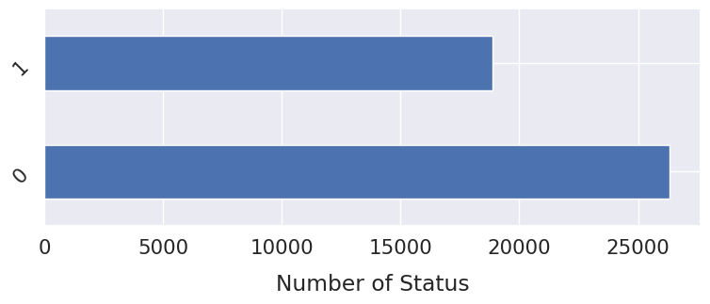
Dataset
10
27-Feb-24
Machine Learning Techniques For Detecting Human Depression Using Social Media Text Data

Slide 12
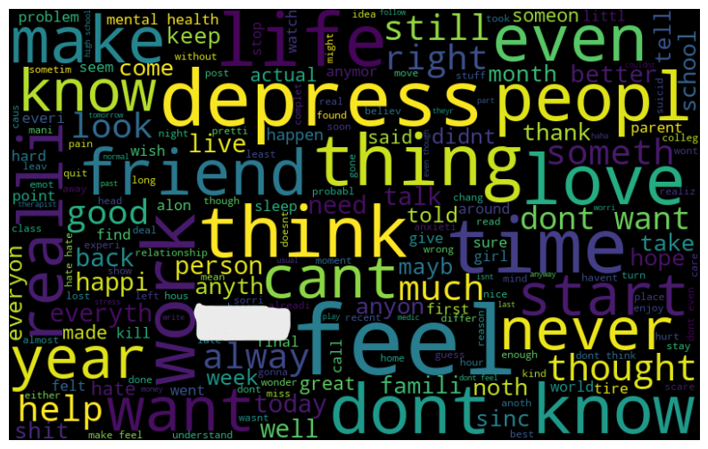
Dataset (1/3)
11
27-Feb-24
Machine Learning Techniques For Detecting Human Depression Using Social Media Text Data

Slide 13
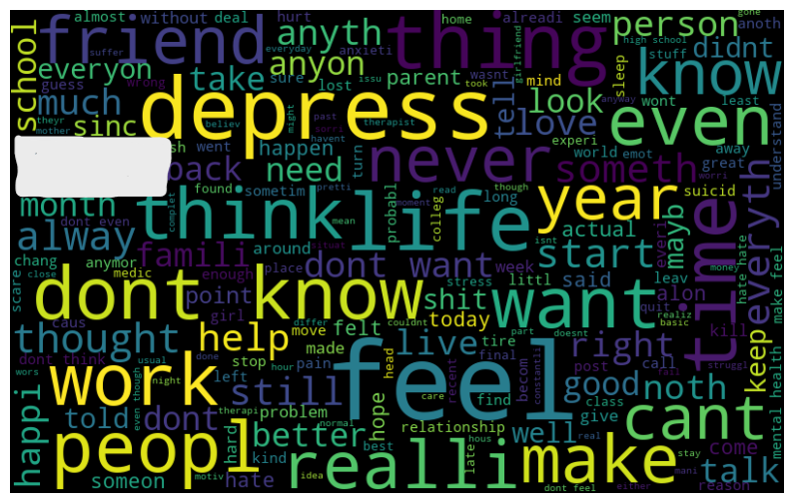
Dataset (2/3)
12
27-Feb-24
Machine Learning Techniques For Detecting Human Depression Using Social Media Text Data

Slide 14
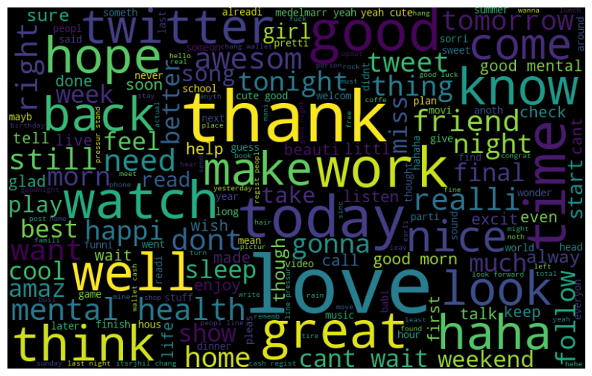
Dataset (3/3)
13
27-Feb-24
Machine Learning Techniques For Detecting Human Depression Using Social Media Text Data

Slide 15
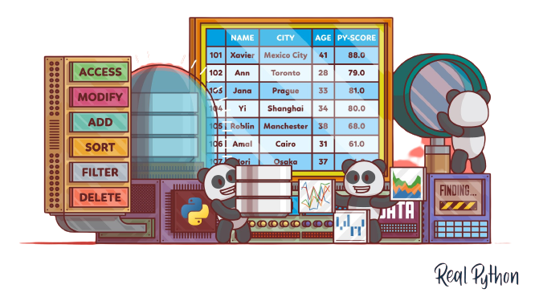
Data Preprocessing(1/2)
Collect data form social media
Data Sorting
Data Labeling
Marge
Removing Unwanted Data
Our Own Dataset
14
27-Feb-24
Machine Learning Techniques For Detecting Human Depression Using Social Media Text Data

Slide 16
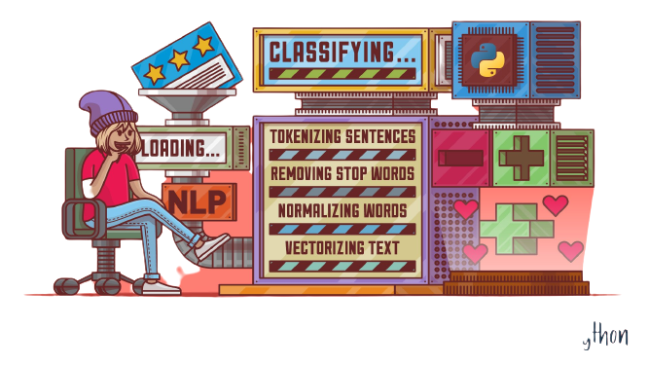
Data Preprocessing(2/2)
Pre-processing
Tokenization
Stop word remove
Punctuation mark remove
Remove all non-alphabetic characters
Porter stemmer
15
27-Feb-24
Machine Learning Techniques For Detecting Human Depression Using Social Media Text Data

Slide 17
Evaluation Matrix (1/3)
TRUE
TRUE
FALSE
FALSE
True Positive (TP) | False Negative (FN) Type II error
False Positive (FP) Type I error | True Negative (TN)
TRUE
FALSE
27-Feb-24
16
Machine Learning Techniques For Detecting Human Depression Using Social Media Text Data

Slide 18
Evaluation Matrix (2/3)
TRUE
FALSE
Accuracy = (true_pos + true_neg) / (true_pos + true_neg + false_pos + false_neg)
Recall = true_pos / (true_pos + false_neg)
F1-score = 2 * precision * recall / (precision + recall)
Precision = true_pos / (true_pos + false_pos)
17
27-Feb-24
Machine Learning Techniques For Detecting Human Depression Using Social Media Text Data

Slide 19
Evaluation Matrix (3/3)
25991
57.48%
334
0.76%
25000
TRUE
FALSE
Not Depressed
20000
True label
15000
1122
2.48%
17761
39.28%
10000
Depressed
5000
Not Depressed
Depressed
18
27-Feb-24
Machine Learning Techniques For Detecting Human Depression Using Social Media Text Data

Slide 20
Experimental Result (1/2)
 | Accuracy | Precision | Recall | F1-Score
TF-IDF | 87.34% | 91.48% | 74.17% | 81.92%
BOW | 73.75% | 92.81% | 34.83% | 50.65%
Logistic Regression | 95.43% | 96.67% | 92.24% | 94.4%
Random Forest | 94.96% | 95.12% | 91.3% | 93.2%
SVC | 95.33% | 96.5% | 92.3% | 94.5%
AdaBoost | 94.67% | 94.98% | 91.5% | 92.3%
XGB Classifier | 95.21% | 96.31% | 92.1% | 94.13%
27-Feb-24
19
Machine Learning Techniques For Detecting Human Depression Using Social Media Text Data

Slide 21
Experimental Result (2/2)
TRUE
FALSE
20
27-Feb-24
Machine Learning Techniques For Detecting Human Depression Using Social Media Text Data

Slide 22
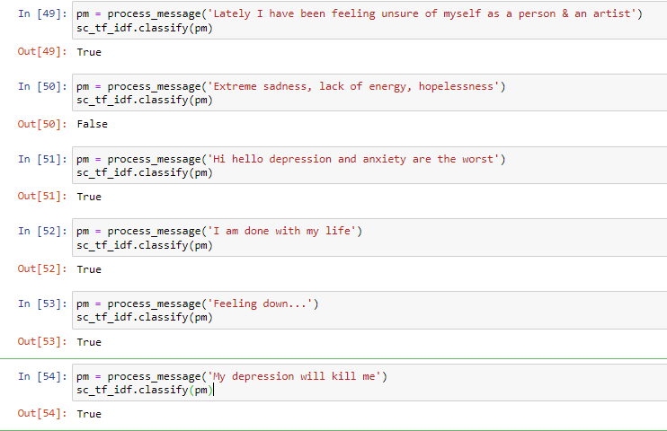
Detecting Depression NLP 1/3
TRUE
FALSE
21
27-Feb-24
Machine Learning Techniques For Detecting Human Depression Using Social Media Text Data

Slide 23
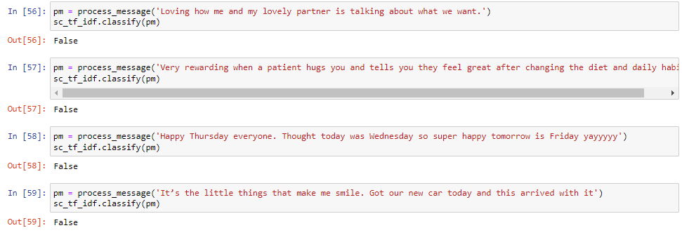
Detecting Depression NLP 2/3
TRUE
FALSE
22
27-Feb-24
Machine Learning Techniques For Detecting Human Depression Using Social Media Text Data

Slide 24
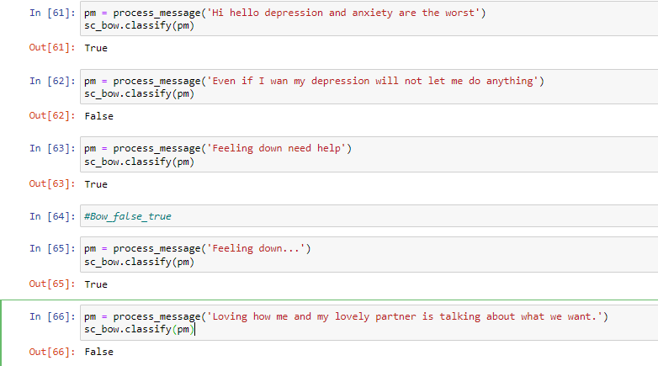
Detecting Depression NLP 3/3
TRUE
FALSE
23
27-Feb-24
Machine Learning Techniques For Detecting Human Depression Using Social Media Text Data

Slide 25
Comparison of Our Existent System 1/2
Dataset | Algorithm | Accuracy | Precision | Recall | F1-Score
Own_Dataset.csv | Logistic Regression | 95.43% | 96.67% | 92.24% | 94.4%
mental_health.csv | Logistic Regression | 90.12% | 92.85% | 87.86% | 90.21%
Own_Dataset.csv | SVC | 95.33% | 96.5% | 92.3% | 94.5%
mental_health.csv | SVC | 89.55% | 92.12% | 86.34% | 89.12%
Own_Dataset.csv | Random Forest Classifier | 94.96% | 95.12% | 91.3% | 93.2%
mental_health.csv | Random Forest Classifier | 89.33% | 90.10% | 89.56% | 88.32%
TRUE
FALSE
27-Feb-24
24
Machine Learning Techniques For Detecting Human Depression Using Social Media Text Data

Slide 26
Comparison of Our Existent System 2/2
Dataset | Algorithm | Accuracy | Precision | Recall | F1-Score
Own_Dataset.csv | Logistic Regression | 95.43% | 96.67% | 92.24% | 94.4%
Depressed.csv | Logistic Regression | 84.40% | 81.55% | 89.45% | 85.21%
Own_Dataset.csv | SVC | 95.33% | 96.5% | 92.3% | 94.5%
Depressed.csv | SVC | 84.52% | 82.43% | 89.81% | 85.75%
Own_Dataset.csv | Random Forest Classifier | 94.96% | 95.12% | 91.3% | 93.2%
Depressed.csv | Random Forest Classifier | 83.34% | 89.21% | 90.94% | 82.84%
TRUE
FALSE
27-Feb-24
25
Machine Learning Techniques For Detecting Human Depression Using Social Media Text Data

Slide 27
Uniqe Concept of Our Existing System
Ensemble learning in Multiple machine learning models are combined to obtain a more accurate model
Logistic Regression
Random Forest
SVC
AdaBoost
XGB Classifier
Ensemble Model
Naive Bayes
Accuracy : 95.47%
26
27-Feb-24
Machine Learning Techniques For Detecting Human Depression Using Social Media Text Data

Slide 28
Gantt Chart
Feb -23 | Mar -23 | Apr -23 | May-23 | Jun -23 | Jul -23 | Aug -23 | Sep -23 | Oct -23 | Nov -23 | Dec -23 | Jan -24
Research and Idea Generation
System Design
Data Collection
Feature Extraction
Model Implementation
Model Training and Testing
Model Evaluation
Interpretation and Analysis
Paper Writing
Final Report and Conclusion
27
27-Feb-24
Machine Learning Techniques For Detecting Human Depression Using Social Media Text Data

Slide 29
Budget
Category | Estimated Cost (BDT)
Computing Resources (Hardware) (Software and Licenses) | 60,000
Data Collection and Access (Data Acquisition) (Data Access Fees) | 12,000
Personal Expenses (Researcher’s) ( Data Analyst) | 22,000
External Services (Ethics Approval) (Transcription Services) | 10,000
Travel and Conferences (Conference Registration) (Travel and Accommodation) (Meals) | 18,000
Publication and Dissemination (Publication Fees) (Printing and Dissemination) | 20,000
Miscellaneous Expenses (Communication and Internet) (Documentation and Training) | 8,000
Total | 1,50,000
28
27-Feb-24
Machine Learning Techniques For Detecting Human Depression Using Social Media Text Data

Slide 30


Challenges
Dataset Problem
Accuracy
False Negative
Word input error
27-Feb-24
29
Machine Learning Techniques For Detecting Human Depression Using Social Media Text Data

Slide 31



Possible Outcomes
Identify depression using text from social media
Understanding of commonly used dataset and features.
Understanding of mostly used algorithm in depression detection.
To make contribution for future depression detection task.
30
27-Feb-24
Machine Learning Techniques For Detecting Human Depression Using Social Media Text Data

Slide 32
Applications
Help out those who have less knowledge about depression
Who has symptoms of depression but can’t determine if they have depression
Understanding of difference of depressed and non-depressed person
31
27-Feb-24
Machine Learning Techniques For Detecting Human Depression Using Social Media Text Data

Slide 33

Scope of Future Works
Multimodal Data Analysis
In future, we can add more data from social media platform
Privacy and Ethical Concerns
Creating better methodology
Education and Awareness
32
27-Feb-24
Machine Learning Techniques For Detecting Human Depression Using Social Media Text Data

Slide 34
Conclusions
This study demonstrate the potential of machine learning in analyzing
Developed models exhibited promising results in accurately
It will allow us to fix the errors or other problems that we faced.
Used both practical and psychological information for better result of our study.
33
27-Feb-24
Machine Learning Techniques For Detecting Human Depression Using Social Media Text Data

Slide 35
References
[1] “Md. Rafqul Islam1*, Muhammad Ashad Kabir2 , Ashir Ahmed3 , Abu Raihan M. Kamal1 , Hua Wang4 and Anwaar Ulhaq5 “ Depression detection from social network data using machine learning techniques," in IEEE Access, vol. 6.
[2] “ Vankayala Tejaswini* , Korra Sathya Babu, Bibhudatta Sahoo" Depression detection from social media text analysis using natural language processing techniques and hybrid deep learning model," in IEEE access, vol. 6, issue 3
[3] “ Dr. Pharindra Sharma, Dambarbhadur Rawal“ Depression detection from social network data using machine learning techniques," Emerging Technologies and Innovative Research, vol. 9, issue. 2
34
27-Feb-24
Machine Learning Techniques For Detecting Human Depression Using Social Media Text Data

Slide 36
Any Question ?
35
27-Feb-24
Machine Learning Techniques For Detecting Human Depression Using Social Media Text Data

Slide 37
Thank You!
36
27-Feb-24
Machine Learning Techniques For Detecting Human Depression Using Social Media Text Data

